Slide 1


Introduction to Free/Libre Software
Raghuram.N
Free Software Movement Karnataka
www.fsmk.org
fsmk-discuss@lists.fsmk.in

Slide 2
Introduction to Free/Libre Software
What is Software?

Slide 3
Introduction to Free/Libre Software
What is meant by Free?

Slide 4
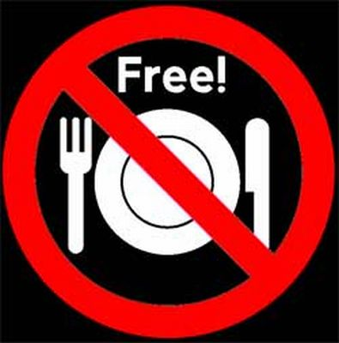
Introduction to Free/Libre Software
Free not as in free lunch(not cost)

Slide 5
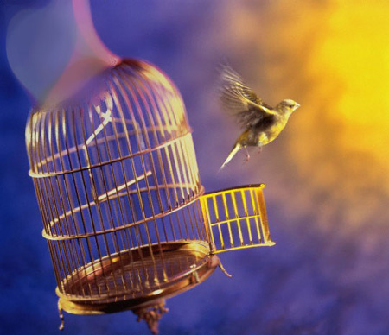
Introduction to Free/Libre Software
Free as in free speech (Freedom)

Slide 6
Introduction to Free/Libre Software
Impact of Technology
Paper
Printing Press
Steam Engine
Computers
Internet

Slide 7
Introduction to Free/Libre Software
Freedom 0
(Use)
The freedom to run the
program, for any purpose.

Slide 8
Introduction to Free/Libre Software
Freedom 1
(Study)
The freedom to study how the program
works, and adapt it to your needs.
(Access to the source code)

Slide 9
Introduction to Free/Libre Software
Freedom 2
(Copy and Share)
The freedom to redistribute copies
so you can help your neighbor

Slide 10
Introduction to Free/Libre Software
Freedom 3
(Modify and Distribute)
The freedom to improve the program,
and release your improvements (and
modified versions in general) to the
public, so that the whole community
benefits

Slide 11
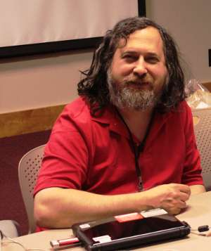
Introduction to Free/Libre Software
The Free Software Foundation was
started by Richard Stallman in 1985.

Slide 12
Introduction to Free/Libre Software
Join Us to Spread Free Software
www.fsmk.org
fsmk-discuss@lists.fsmk.in
https://www.facebook.com/groups/151309701578334/

